Slide 1
Measurement Notes

Slide 2
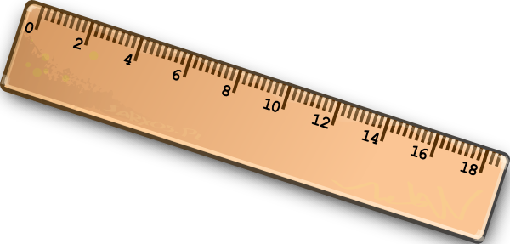
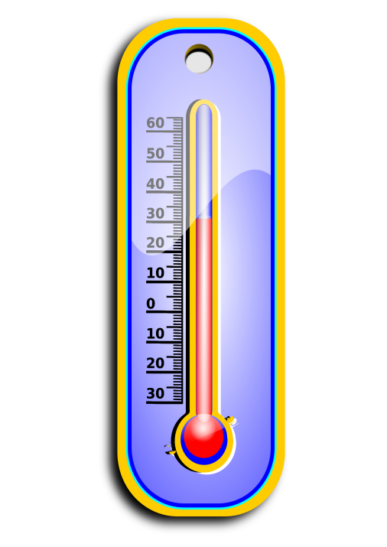
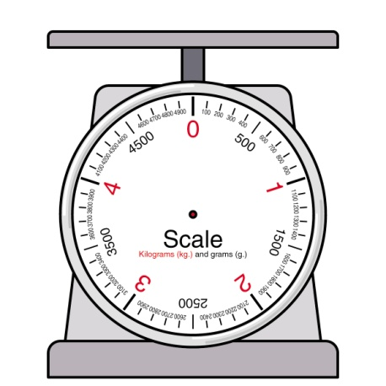
Measured most often
Length
Mass
Time
Temperature

Slide 3
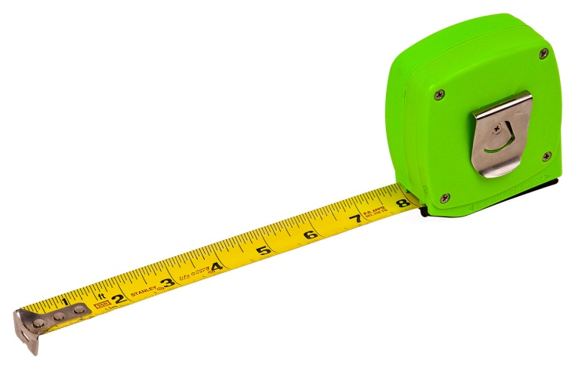
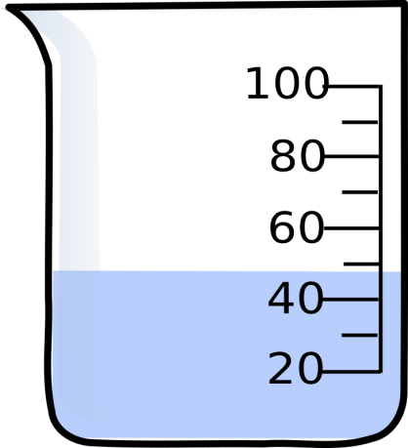
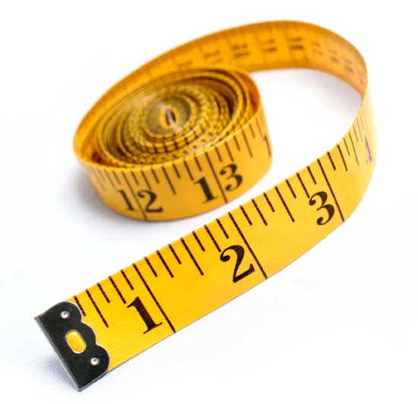
Measuring Tools
Scale
Ruler
Meter/year stick
Cloth tape measure
Metal retractable tape measure
Measuring cup
Thermometer

Slide 4
Metric System
Based on the number 10
Used in most of the world
Gram = weight
Meter = distance
Base terms we use the most

Slide 5
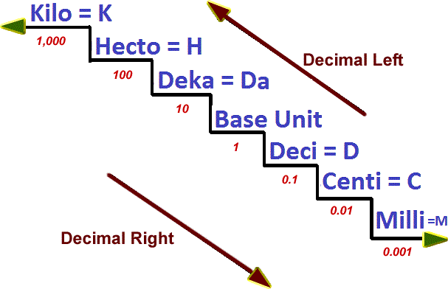

Slide 6
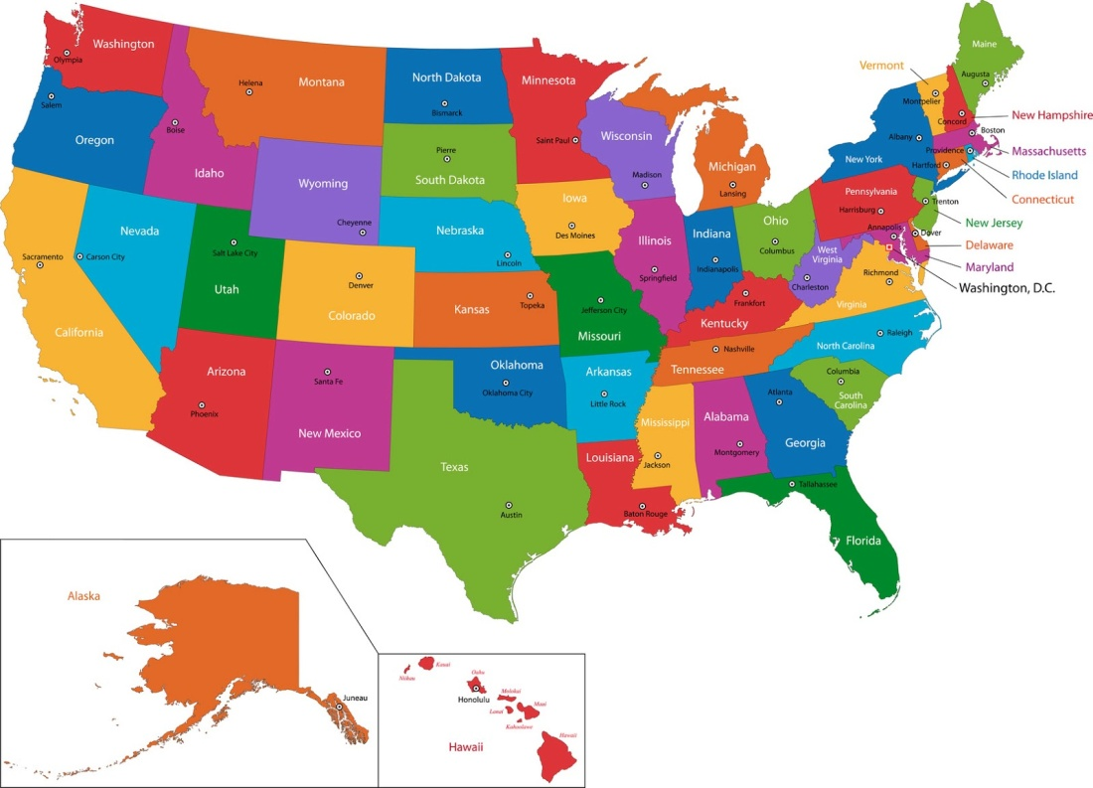
Standard System
Based on many different numbers
Used mainly in the United States of America

Slide 7
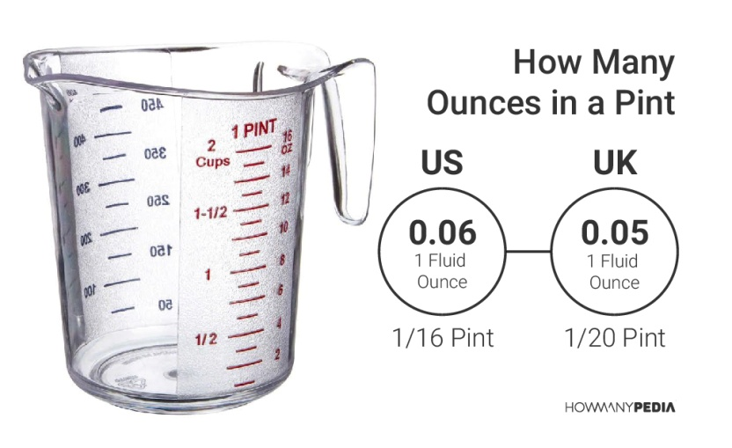
A Pint is a Pound the World Around
Ounces can be used to measure both solids and liquids in the standard system
2 cups = 1 pint
2 cups = 16 ounces
16 ounces = 1 pound

Slide 8
Important Abbreviations
Gram = g Meter = m
Pound = lbs. Ounce = oz.
Inches = in. or “ Feet = ft. or ‘
Fahrenheit = F Celsius = C

